Slide 1
Allure vs ReportPortal.io

Slide 2
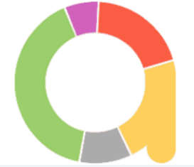
Allure
There are lots of cool testing frameworks for different programming languages. Unfortunately only a few of them can provide good representation of test execution output. The Qameta Software testing team is working on Allure – an open-source framework designed to create test execution reports that are clear to everyone in the team.
Allure Report is a flexible multi-language test report tool to show you a detailed representation of what has been tested end extract max from the everyday execution of tests.

Slide 3
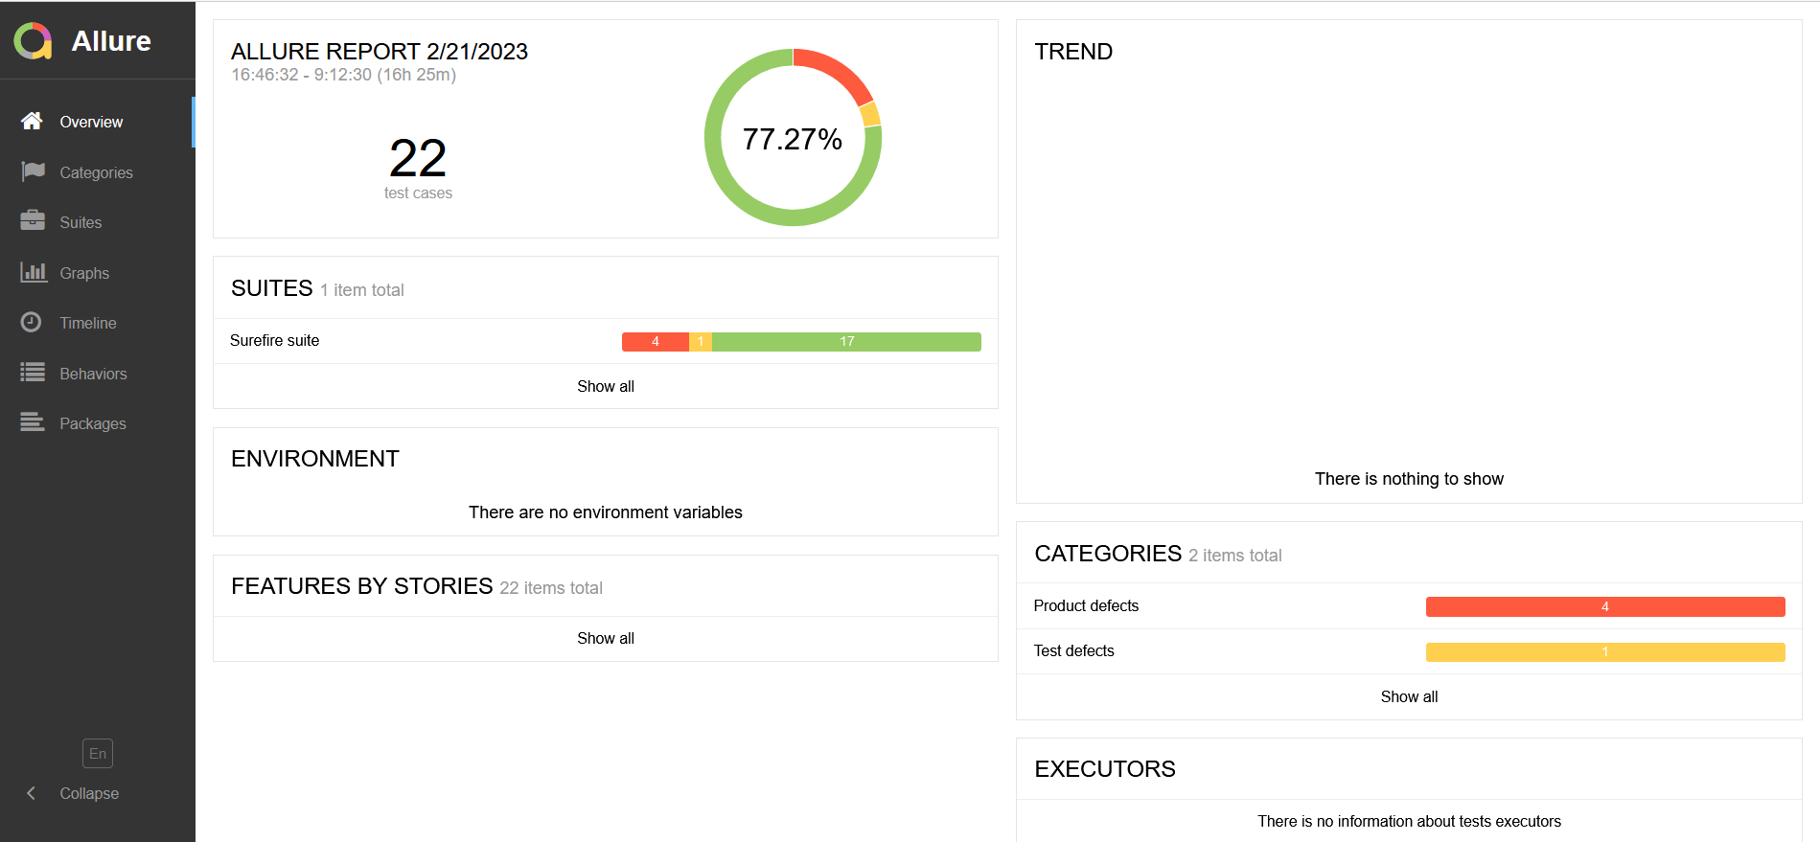
Allure - Overview

Slide 4
How does Allure work?
Gather testing data
1
Getting testing data during tests run using allure framework
Collect previous results
2
This step is optional. We take history of previous runs here
Report generation
3
Using Allure CLI to generate a report

Slide 5
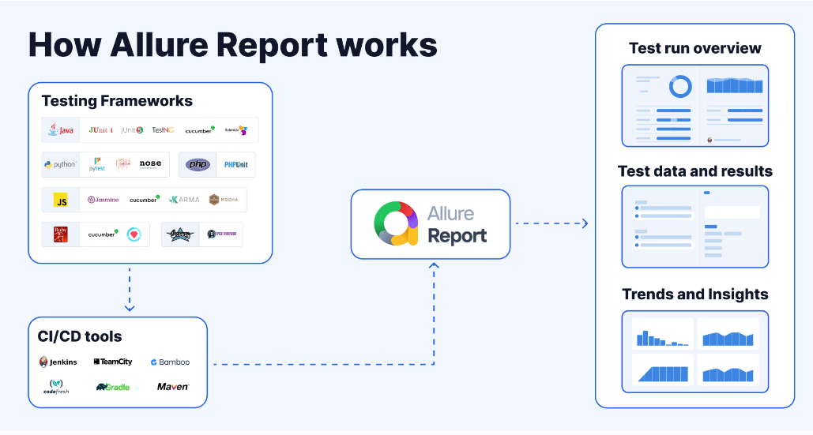

Slide 6
Allure: pros and cons
Pros
Cons
Easy to start
Free to use (open source)
Works autonomously (Allure doesn’t need any server or DB)
Requirements (JRE, Allure CLI)
Runs history storage problem
Compatibility of reports with modern browsers

Slide 7

ReportPortal.io
It’s a service that provides increased capabilities to speed up results analysis and reporting through the use of built-in analytic features.
ReportPortal is a great addition to Continuous Integration and Continuous Testing process.

Slide 8
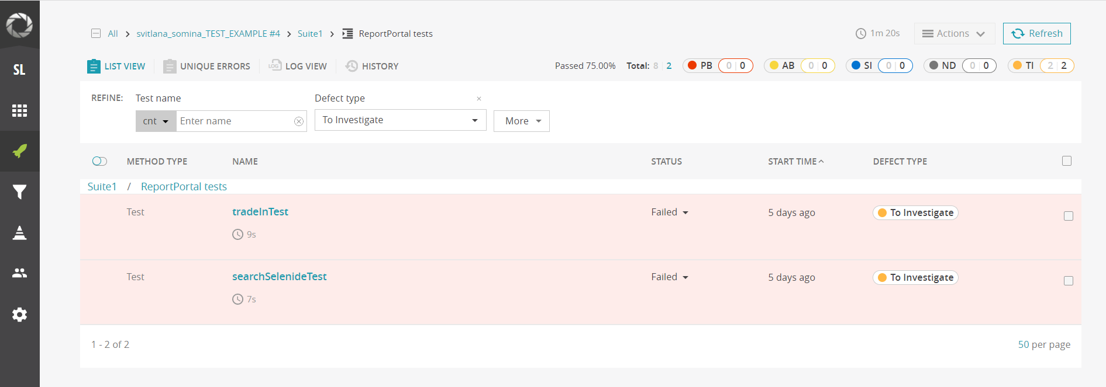
ReportPortal.io

Slide 9
What ReportPortal can do?
Mainstream platforms integration. ReportPortal integrates with mainstream platforms such as Jenkins, Jira, BDD process.
Real-time integration. Real-time integration provides businesses the ability to manage and track execution status directly from the ReportPortal.
Test case execution results structure. Test case execution results are stored following the same structure you have in your reporting suites and test plan. The test cases are shown together with all related data in one place, right where you need it: logs, screenshots, binary data.
Collaborative analysis. ReportPortal also gives you the ability to collaboratively analyze the test automation results. Particular test cases can be associated with a product bug, an automation issue, a system issue or can be submitted as an issue ticket directly from the execution result.
Historical data of test execution. ReportPortal provides enhanced capabilities along with auto-results analysis by leveraging historical data of test execution.
Automatic Analysis With each execution, ReportPortal automatically figures out the root cause of a fail. As a result of this analysis, ReportPortal is marking a test result with a flag. Engineers will be alerted about this issue to provide further analysis.

Slide 10
How does ReportPortal.io work?
Gather testing data
1
Getting testing data during tests run using ReportPortal.io framework
Send results to the server
2
Sending data to ReportPortal.io server using it’s framework

Slide 11
ReportPortal.io: pros and cons
Pros
Cons
Free to use (open source)
Reports storage
Dynamic runs
Integrations. Docker, Ubuntu, Jira, Jenkins, and Kubernetes are some of the popular tools that integrate with ReportPortal.
Requirements (server, resources)
Some libs got lack of functionality

Slide 12
What to choose?
Allure
ReportPortal.io
No runs history needed
Single test project
Multiple projects
Test results analysis
CI/CD integration

